Slide 1
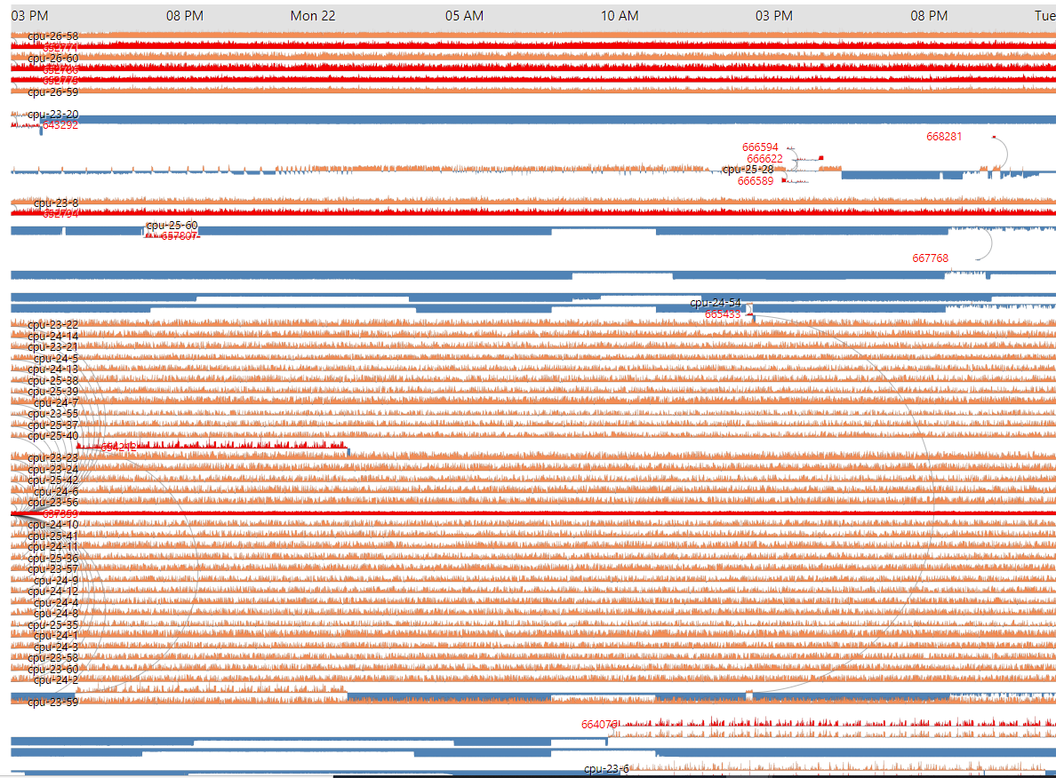
Job Power
Weekly report

Slide 2
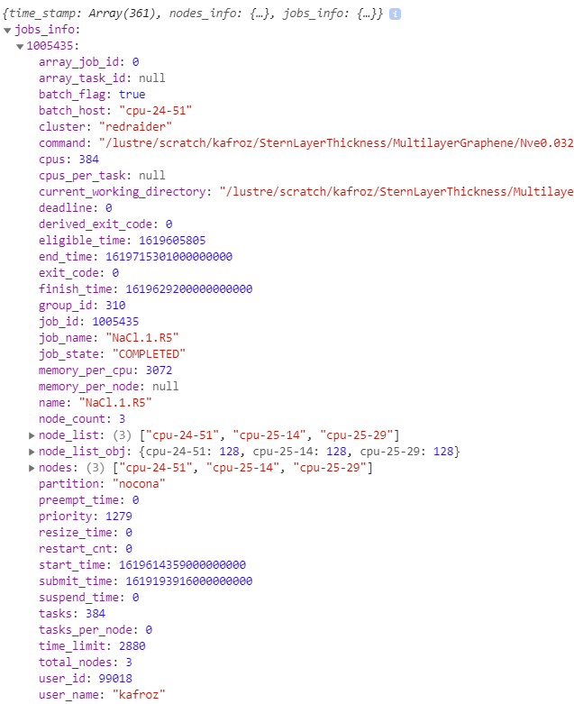
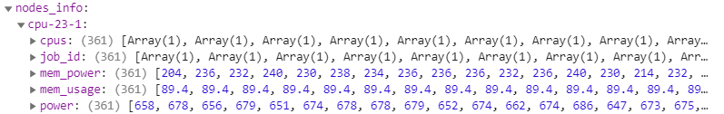
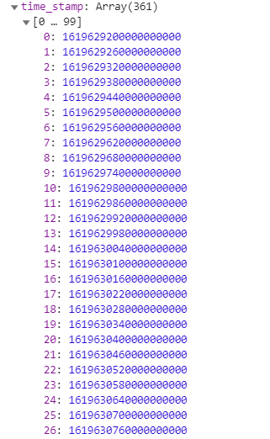
From May 11, 2021 12:00 to 18:00
361 timesteps (1 minutes interval)

Slide 3
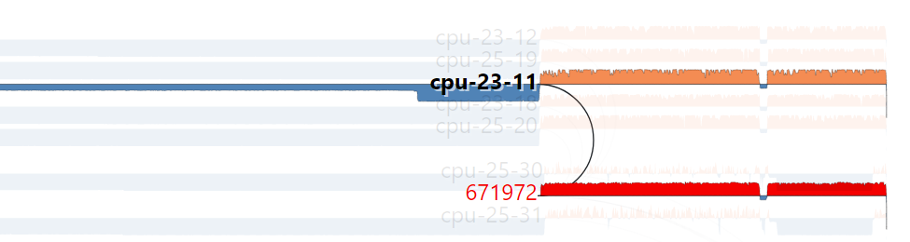
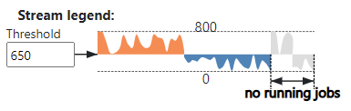
https://idatavisualizationlab.github.io/HPCC/JobPower/index.html
Power Stream
compute
The link is drawn when jobs start
Job
Orange: above Threshold
Blue: below Threshold

Slide 4
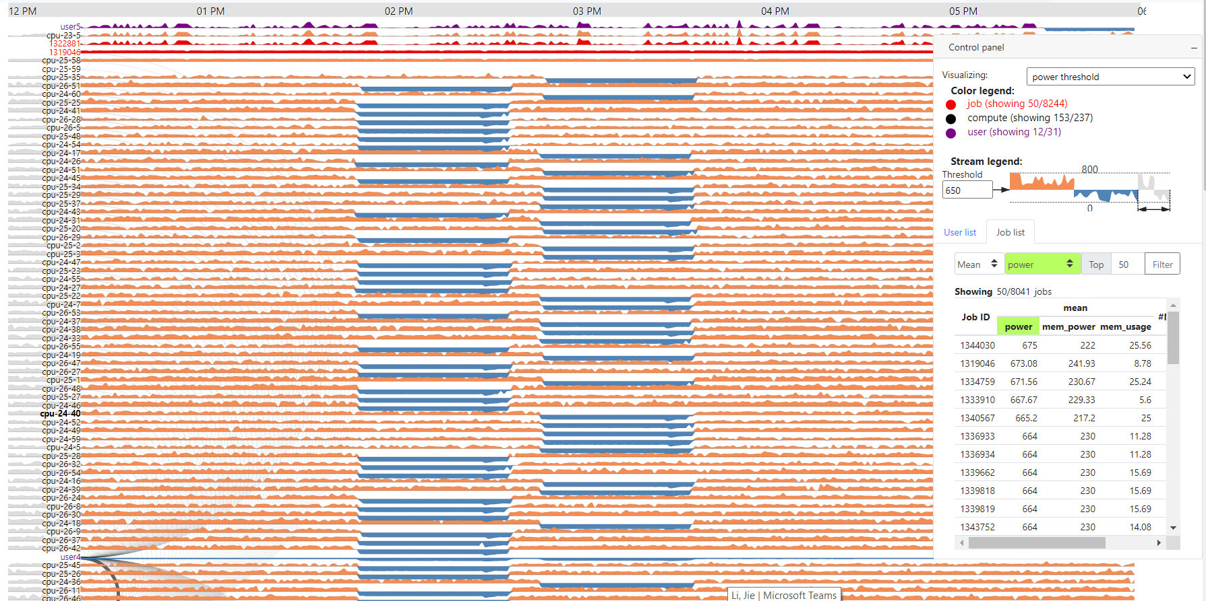
Job Power
user4 = jieyao

Slide 5
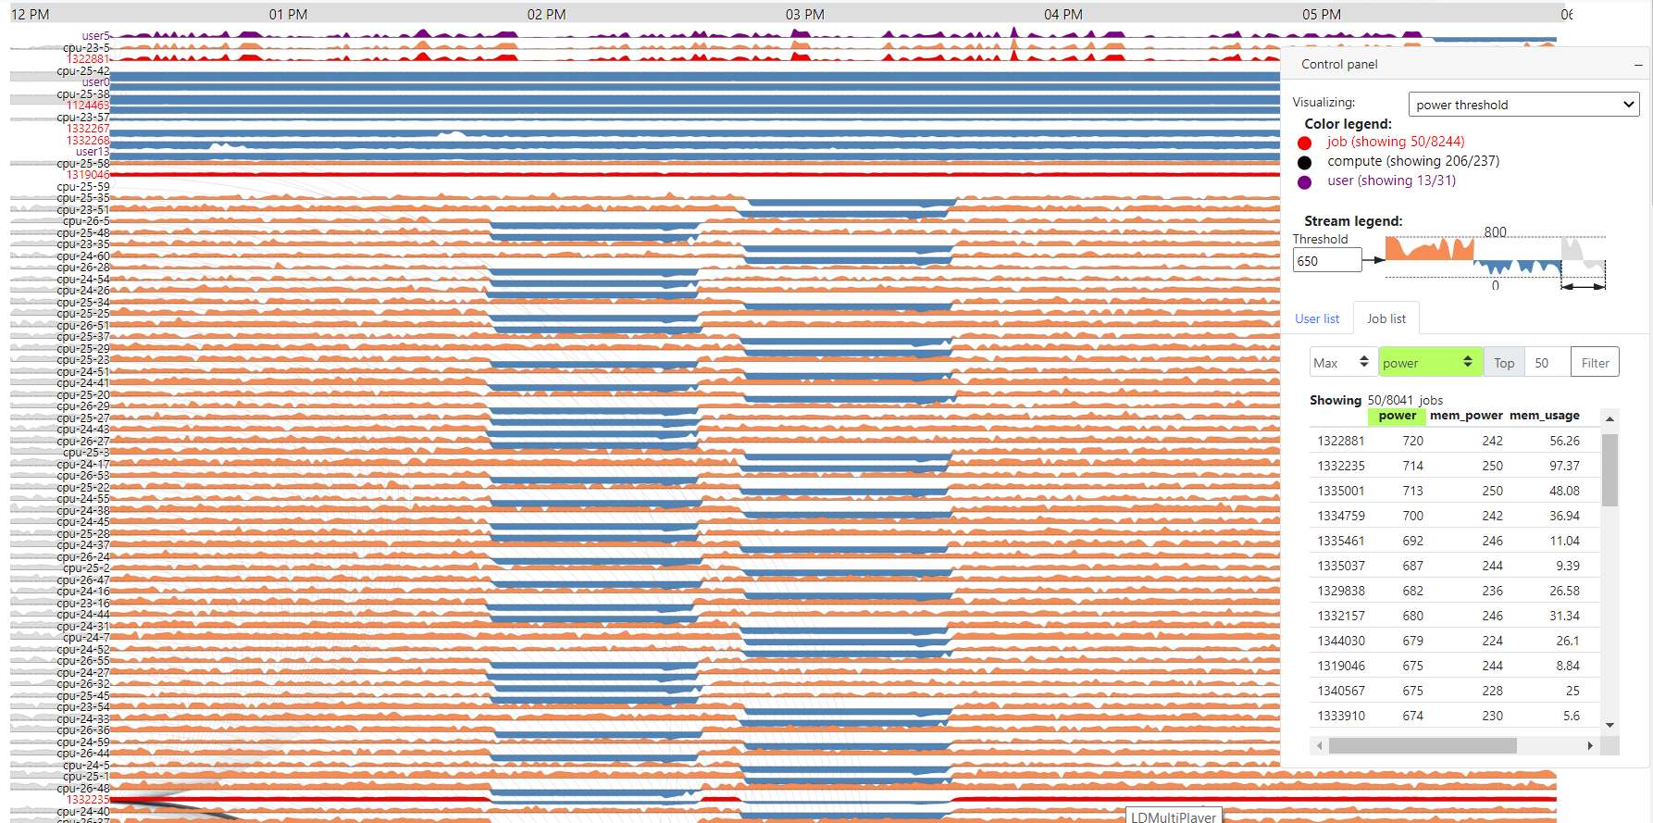
Job Power
Top 50 max Power
132881 submitted by user5 (fmolajaf)

Slide 6
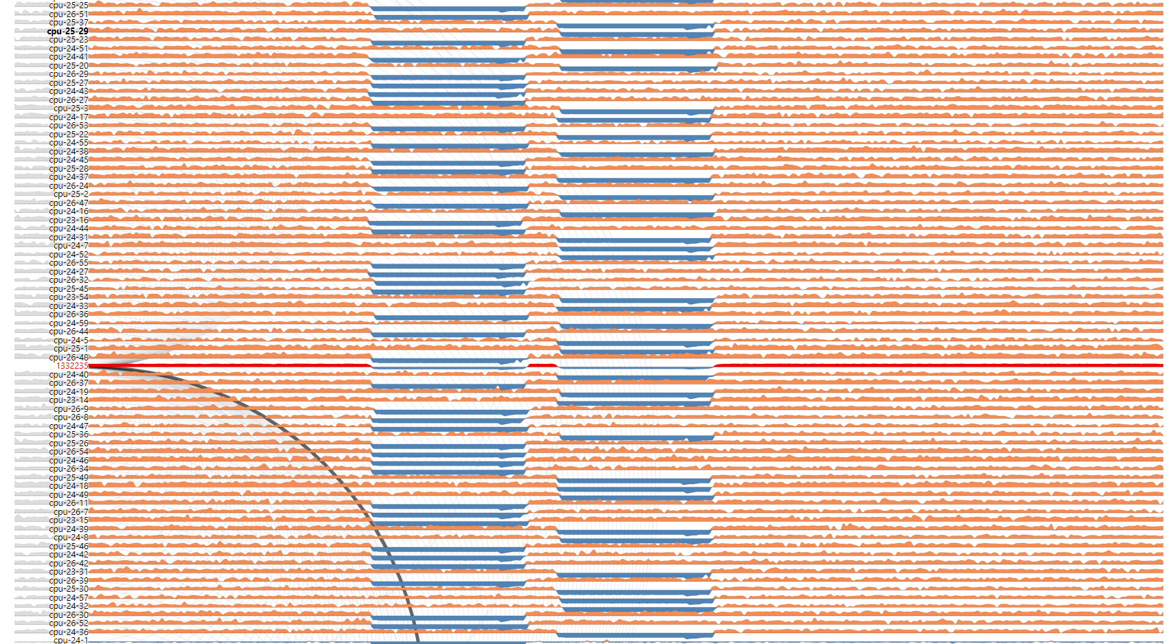
Job Power
Top 50 max Power
1332235 submitted by user4 (jieyao)
This job is also the highest mem_power and mem_usage

Slide 7
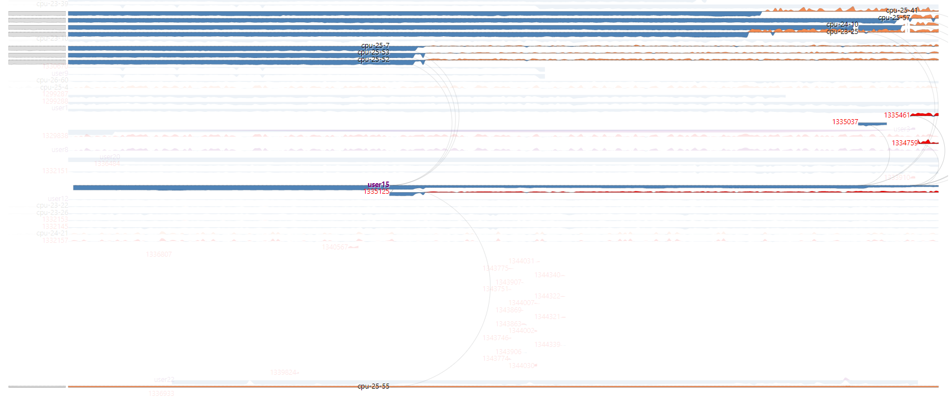
Job Power
Top 50 max Power
1334759, 1335461 submitted by unknown
Unknow is the dummy user present for job which isn’t listed in job_info

Slide 8
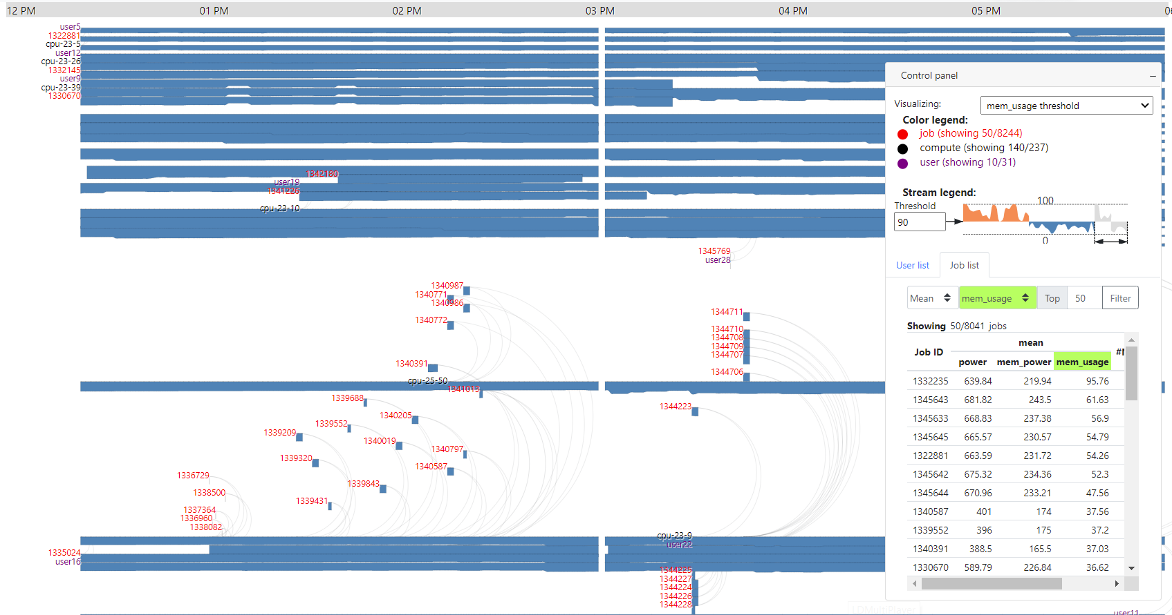
Job Power
Mising data for mem_usage

Slide 9
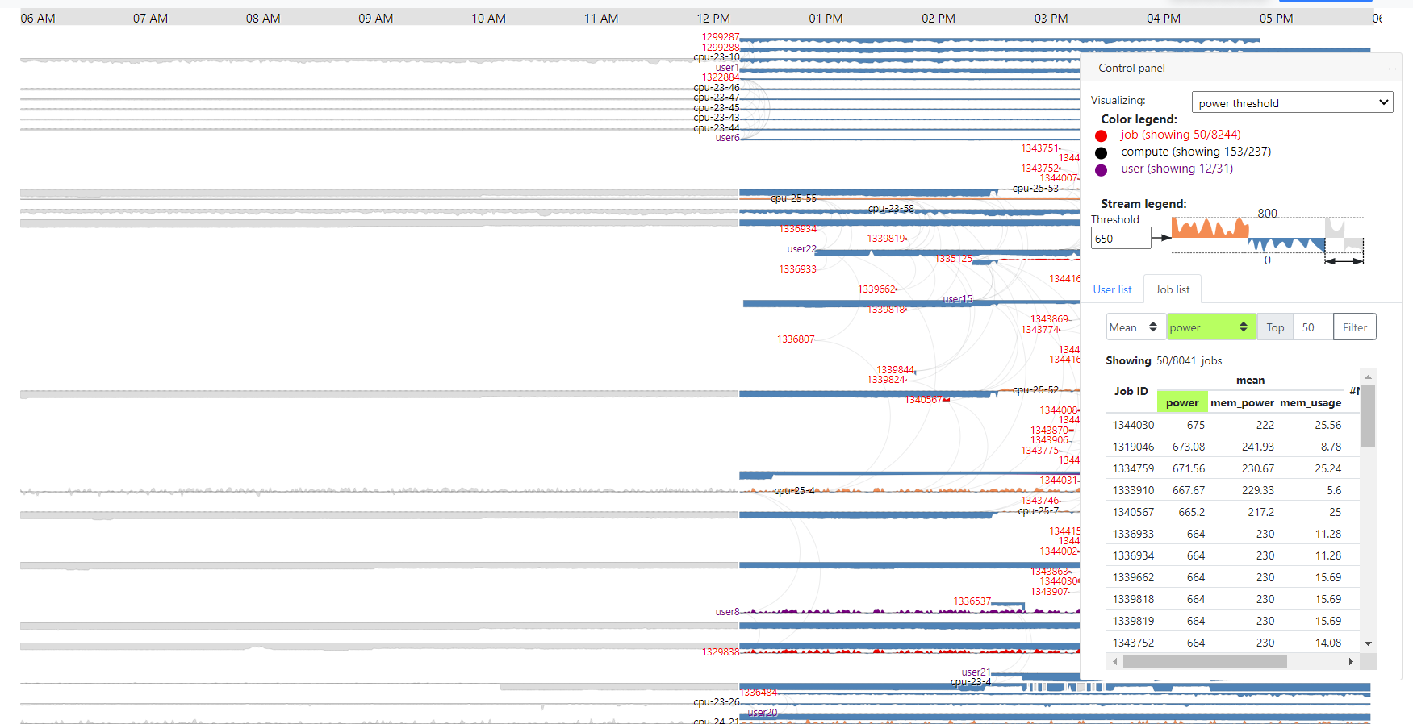
Job Power
Problem with job_info for 12h data

